Slide 1
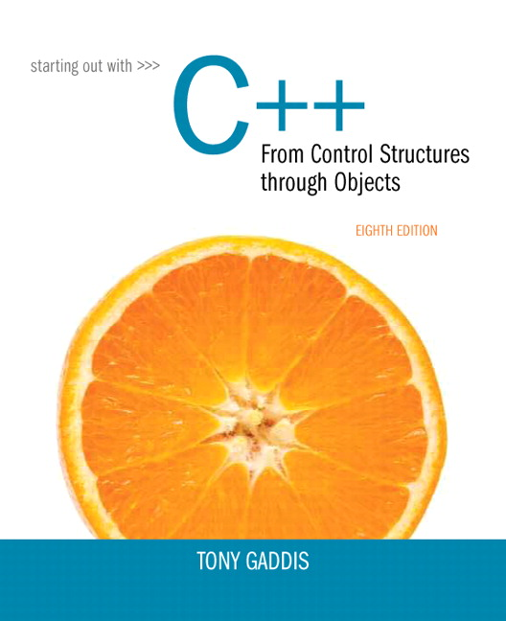
Chapter 4:
Making Decisions
Study Suggestions

Slide 2
Section 4.1 – Relational Operators
Checkpoint pp 153 – 154.
Write a program that prints out the result of the following expression: 3 == 3 > 0 Is this true or false? Why? Which relational operator (“equality test” or “greater than”) executes first?
Do similar experiments with other combinations.
If you make a mistake with the above expression and use a single equal sign instead of a double, does it compile? Why or why not?
Change the left most “3” to a “1”. What is the output now? Why?

Slide 3
Section 4.2 – The if Statement
Checkpoint p. 162.
Write an if statement that performs the following logic: If the variable price is greater than 1000, then assign 0.25 to the variable discountRate.
Write an if statement that performs the following logic: If the variable x is equal to 20, then assign 0 to the variable y.
Code these up and verify that they worked by printing out the values of the variables both before and after the if.

Slide 4
Section 4.3 – Expanding the if Statement
Checkpoint p. 165.
The following code is syntactically correct, but contains a logic error (Checkpoint 4.10): if (interestRate > 0.07) cout << “This account earns a $10 bonus.\n”; balance += 10.0;
What values for interestRate reveal the error?
How do we fix the problem?
Code this up and verify both the problem and the solution.

Slide 5
Section 4.4 – The if/else Statement
Checkpoint 4.12, p 168. Code both of these up and test them.
Write and if/else statement that assigns a 5 to x if y is even. Otherwise, it assigns a 0.

Slide 6
Section 4.5 - Flags
Checkpoint p 175.
The “Dangling else” problem can be a serious issue.
Implement the code in Slide 33 as it is and verify that it does not work as expected. (You can do this by trying various values for x and y. Any x<=5 or if x > 5 but y <= 5 should cause these statements to malfunction.) Then implement the code in slide 35, test it with the same numbers, and verify that it now works correctly with the same input values.

Slide 7
Section 4.6 – Logical Operators
Examine Checkpoint 4.16 (p180) and decide what the answer is. Then copy that section of code into a C++ program and verify that your answer is correct.
Do the same thing with Checkpoint 4.17. How many coupons would be given for exactly 3 books? Why?

Slide 8
Section 4.7 – Numeric Ranges
Note that since bool variables must either be true or false, if (boolVar == true) will work the same as if (boolVar).
Code this up to verify.

Slide 9
Section 4.8 – Logical Operators
Checkpoint 4.19, p190. Do each problem. Determine the answer first by looking at it and doing the analysis. Then code them up in an actual C++ program to verify your answers.
Create conditions using AND’s and OR’s, negate them using De Morgan Laws, and code up examples that prove that the negation was done correctly.

Slide 10
Section 4.9 – Numeric Ranges
Checkpoint 4.20 and 4.21, p 190.
For what values of x is the following if statement true? if ( x <= 5 && x >= 10 )
For what values of x is the following if statement true? if ( x >= 5 || x <= 10 )

Slide 11
Section 4.11 – Validating User Input
Let’s say that valid input for our program is an integer that is greater than or equal to 10, but strictly less than 20. We set up an input validation loop as follows: while (input >= 10 || input < 20) ...
Is that correct? Why or why not?
For which values of input will that loop condition be true?

Slide 12
Section 4.12 – Comparing Characters and Strings
Checkpoint, p 198.
Are lower case letters “greater than” or “less than” their corresponding upper case letters? Why?

Slide 13
Section 4.13 – The Conditional Operator
Checkpoint, p 201-202.

Slide 14
Section 4.14 – The switch Statement
Checkpoint, pp 209-211.
Note that menus can be created either with a switch statement or with an if-else-if construct.
Some issues and questions:
Which one can handle ranges better?
How does each structure handle the situation when there is no match?
If we wanted to trap for, say, a little ‘a’ and a capital ‘A’ with a switch statement, how do we do that? How do we do that with an if-else-if structure?

